Slide 1
Chapter 7
Budgeting and Risk Management

Slide 2
Budgeting (Slide 1 of 2)
Budgeting is the allocation of scarce resources to the various endeavors of an organization
A budget is a plan for the costs of project resources
A budget implies constraints
Thus, it implies that managers will not get everything they want or need
7-<number>

Slide 3
Budgeting (Slide 2 of 2)
The budget for an activity also implies management support for that activity
Higher the budget, relative to cost, higher the managerial support
The budget is also a monitoring & control mechanism
  Many organizations have controls in place that prohibit exceeding the budget
  Comparisons are against the budget
7-<number>

Slide 4
Estimating Project Budgets
Like any forecast, this includes some uncertainty
There is uncertainty regarding usage and price
  Especially true for material and labor
The more standardized the project and components, the lower the uncertainty
The more experienced the cost estimator, the lower the uncertainty
Can use previous, similar projects as guides
7-<number>

Slide 5
Rules of Thumb
Some estimates are prepared by rules of thumb
  Construction cost by square feet
  Printing cost by number of pages
  Lawn care cost by square feet of lawn
These rules of thumb may be adjusted for special conditions
However, this is still easier than starting the estimate from scratch
7-<number>

Slide 6
Budgeting Concepts
Tradition
Life cycle costing
Actual costs and earned value analysis
Tracing expenses to specific tasks
7-<number>

Slide 7
Estimating Budgets is Difficult (slide 1 of 2)
There may not be as much historical data or none at all
Even with similar projects, there may be significant differences
Many people have input to the budget
7-<number>

Slide 8
Estimating Budgets is Difficult (Slide 2 of 2)
Multiple people have some control over the budget
There is more “flexibility” regarding the estimates of inputs (material and labor)
The accounting system may not be set up to track project data
Usage of labor and material is very lumpy over time
7-<number>

Slide 9
Types of Budgeting
Top-down
Bottom-up
Negotiated
7-<number>

Slide 10
Top-Down Budgeting
Top managers estimate/decide on the overall budget for the project
These trickle down through the organization where the estimates are broken down into greater detail at each lower level
Sometimes viewed as zero-sum game
The process continues to the bottom level
7-<number>

Slide 11
Advantages
Overall project budgets can be set/controlled very accurately
  A few elements may have significant error
Management has more control over budgets
Small tasks need not be identified individually
7-<number>

Slide 12
Disadvantages
More difficult to get buy in
Leads to low level competition for larger shares of budget
7-<number>

Slide 13
Bottom-Up Budgeting
Project is broken down into work packages
Low level managers price out each work package
Overhead and profits are added to develop the budget
7-<number>

Slide 14
Reserve Analysis
Contingency reserve
Management reserve
7-<number>

Slide 15
Advantages
Greater buy in by low level managers
More likely to catch unusual expenses
7-<number>

Slide 16
Disadvantages
People tend to overstate their budget requirements
Management tends to cut the budget
7-<number>

Slide 17
Work Element Costing
Labor rates include overhead and personal time
Direct costs usually do not include overhead
General and administrative (G&A) charge
7-<number>

Slide 18
Estimation Examples
Assume a work element is estimated to require 25 hours of labor by a technician.
The specific technician is paid $17.50/hr.
Overhead charges to the project are 84 percent of direct labor charges
25 hr × $17.50 × 1.84 = $805.00
Assume 12% personal time
1.12 × 25 hr × $17.50 × 1.84 = $901.60
7-<number>

Slide 19
An Iterative Budgeting Process–Negotiation-in-Action
Most projects use some combination of top-down and bottom-up budgeting
Both are prepared and compared
Any differences are negotiated
7-<number>

Slide 20
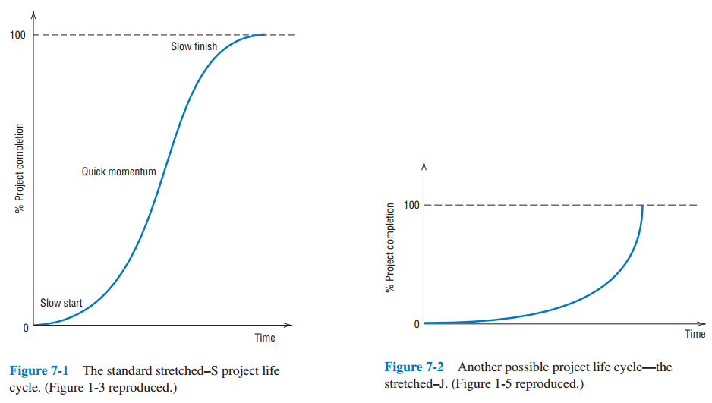
Opposing Views of Superior and Subordinate
7-<number>

Slide 21
Category Budgeting Versus Program/Activity Budgeting
Organizations are used to budgeting (and collecting data) by activity
These activities correspond to “line items” in the budget
  Examples include phone, utilities, direct labor,…
Projects need to accumulate data and control expenses differently
This resulted in program budgeting
7-<number>

Slide 22
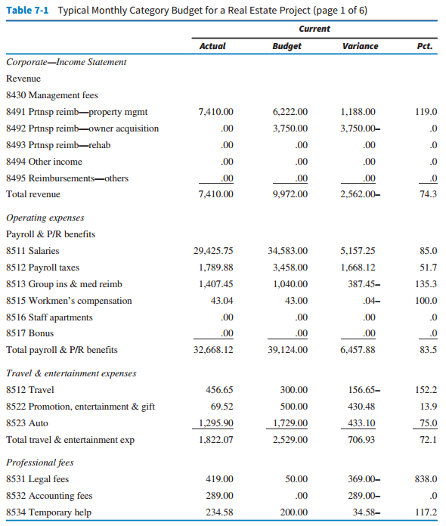
Typical Monthly Budget
7-<number>

Slide 23
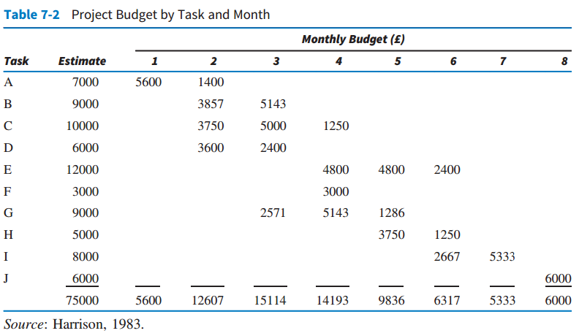
Project Budget by Task & Month
7-<number>

Slide 24
Improving The Process of Cost Estimation
Inputs from a lot of areas are required to estimate a project
May have a professional cost estimator to do the job
  Their primary job is to reduce uncertainty
Project manager will work closely with cost estimator when planning a project
We are primarily interested in estimating direct costs
Indirect costs are not a major concern
7-<number>

Slide 25
Problems
Even with careful planning, estimates are wrong
Most firms add 5-10 percent for contingencies
7-<number>

Slide 26
Not Always About The Profit
To develop knowledge of a technology
To get the organization’s “foot in the door”
To obtain the parts or service portion of the work
To be in a good position for a follow-on contract
To improve a competitive position
To broaden a product line or a line of business
7-26

Slide 27
Project Bids and RFPs
The project proposal is essentially a project bid
Putting together a project proposal requires a detailed analysis of the project
Project proposals can take weeks or months to complete
A more detailed analysis may result in not bidding on the project
7-27

Slide 28
Questions To Consider
Which projects should be bid on?
How should the proposal-preparation process be organized and staffed?
How much should be spent on preparing proposals for bids?
How should the bid prices be set? What is the bidding strategy? Is it ethical?
7-28

Slide 29
Project Proposal Contents
Cover letter
Executive summary
The technical approach
The implementation plan
The plan for logistic support and administration
Past experience
7-29

Slide 30
Learning Curves
Human performance usually improves when a task is repeated
This happens by a fixed percent each time the production doubles
Percentage is called the learning rate
7-<number>

Slide 31
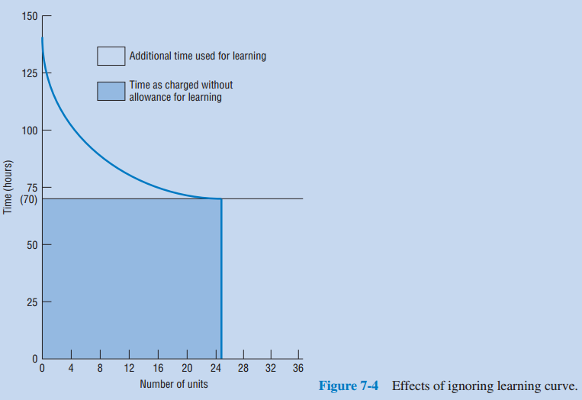
Learning Curves
7-<number>

Slide 32
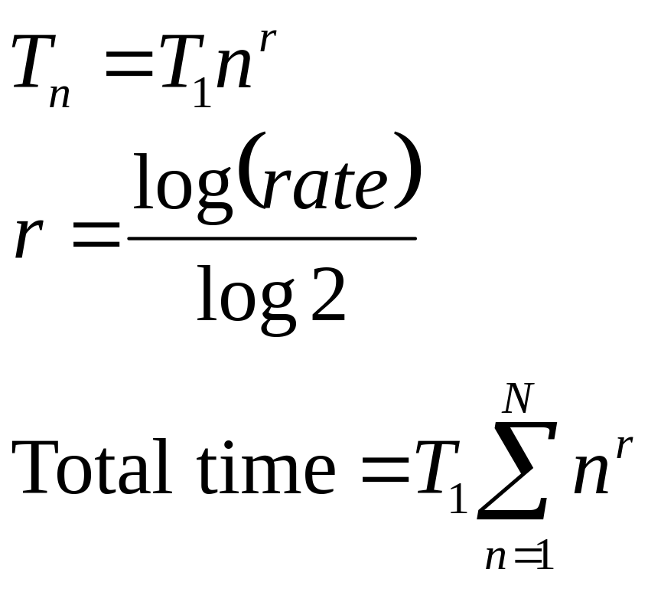
Learning Curve Calculations
T_{n} = Time for nth unit
T₁ = Time for first unit
n = Number of units
r = log decimal rate/log 2
7-<number>

Slide 33
A Special Case of Learning –
Technological Shock
New systems may promise efficiency, but it may take time to realize
7-<number>

Slide 34
Other Factors
Escalation
Waste
Bad Luck
7-<number>

Slide 35
Project Risk Management
Considerable more interest in risk management now
The human factor is probably the major element
Consider risk attitude or tolerance
Tailor risk communication to the audience
7-35

Slide 36
Subprocesses of Risk Management
Risk management planning
Risk identification
Qualitative risk analysis
Quantitative risk analysis
Risk response planning
Risk monitoring and control
The risk management register
7-36

Slide 37
Risk Management Planning
Need to know the risk involved before selecting a project
Risk management plan must be carried out before the project can be formally selected
At first, focus is on externalities
  Track and estimate project survival
Project risks take shape during planning
Often handled by project office
7-37

Slide 38
Risk Management Planning
Types of risks
  Preventable
  Strategy
  External
7-38

Slide 39
Risk Identification
Risk is dependent on technology and environmental factors
Delphi method is useful for identifying project risks
Other methods include brainstorming, nominal group techniques, checklists, attribute listing, and EWS.
May also use cause-effect diagrams, flow charts, influence charts, SWOT analysis
7-<number>

Slide 40
Qualitative Risk Analysis
Purpose is to prioritize risks
A sense of the impact is also needed
Each objective should be scaled and weighted
Construct a risk matrix
Same approach can be used for opportunities
7-<number>

Slide 41
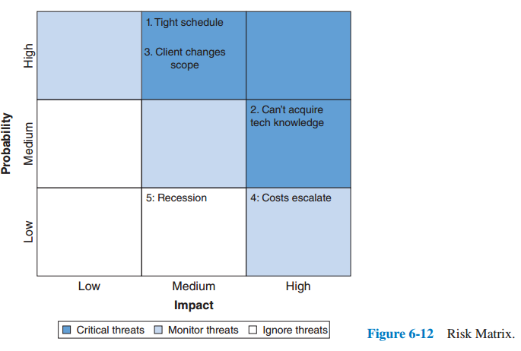
Risk Matrix
Figure 7.6 Risk Matrix
7-<number>

Slide 42
International Project Risk Categories
Cultural
Political
Regional
Virtual
7-<number>

Slide 43
Quantitative Risk Analysis
More precise than qualitative
Typically more accurate
Three techniques:
  Failure Mode and Effect Analysis
  Decision Tree Analysis
  Simulation
7-<number>

Slide 44
Risk Response Planning
Threats
  Avoid
  Transfer
  Mitigate
  Accept
Opportunities
  Exploit
  Share
  Enhance
  Accept
7-<number>

Slide 45
Risk Monitoring and Control
Monitoring covered in detail in Chapter 10
Control covered in Chapter 11
7-<number>

Slide 46
The Risk Register
Environments that may impact projects
Assumptions made
Risks identified
List of categories and key words
Estimates on risk, states of project’s environment, or on project assumptions
Minutes
Actual outcomes
7-<number>

Slide 47
Quantitative Risk Assessment
7-<number>

Slide 48
Failure Mode and Effect Analysis
List ways a project can fail
Evaluate severity
Estimate likelihood
Estimate the inability to detect
Find the risk priority number (RPN) (RPN = S × L × D)
Consider ways to reduce the S, L, and D for each cause of failure
7-<number>

Slide 49
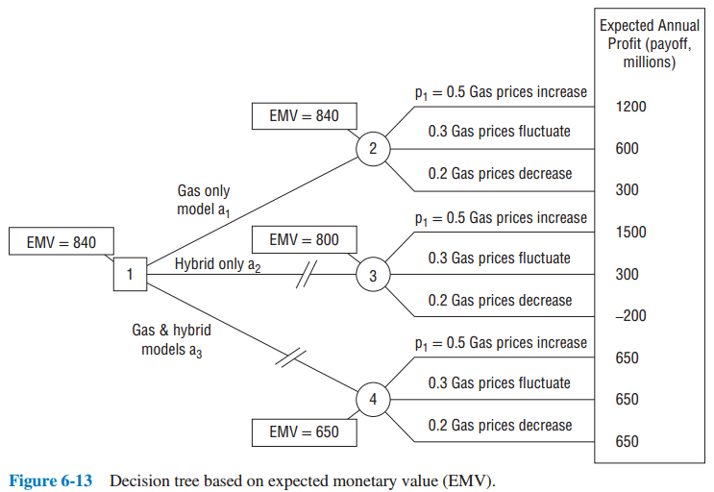
Decision Tree Analysis
Figure 7.7
7-<number>

Slide 50
General Simulation Analysis
Simulation combined with sensitivity analysis is useful for evaluating projects
Would support project if NPV is positive and is the best use of funds
Should avoid full-cost philosophy
  Some overheads are not affected by changes
Analysis gives a picture in terms of costs and times that will be affected
Project is then reviewed using simulation
7-<number>

Slide 51
Monte Carlo Simulation
Can handle both threats and opportunities and sequential events
7-<number>

Slide 52
Sensitivity Analysis
Also referred to as “What-if” analysis
Can be used for quantitative and qualitative models
Process includes going back into the model to change one parameter and see impact on final result
Weakness: In reality, a single change in environment doesn’t happen
There is also “scenario sensitivity analysis”
7-<number>

Slide 53
Dealing With Project Disasters
What to do if a loss is catastrophic?
  Even if the probability is low
Buy insurance
What if insurance isn’t available?
Four approaches for project disaster planning
  Risk analysis
  Contingency planning
  Developing logic charts
  Tabletop Exercises
7-<number>

Slide 54
Copyright
Copyright © 2018 John Wiley & Sons, Inc.
All rights reserved. Reproduction or translation of this work beyond that permitted in Section 117 of the 1976 United States Act without the express written permission of the copyright owner is unlawful. Request for further information should be addressed to the Permissions Department, John Wiley & Sons, Inc. The purchaser may make back-up copies for his/her own use only and not for distribution or resale. The Publisher assumes no responsibility for errors, omissions, or damages, caused by the use of these programs or from the use of the information contained herein.
7-<number>

